Slide 1
Single Pass Spectrogram Inversion
Presented at:
IEEE DSP 2015, Singapore
Authors:
Gerald T. Beauregard
Mithila Harish
Lonce Wyse

Slide 2
Agenda
Problem formulation
Algorithm
Evaluation
Future Study
Notes:
Just say:
Introduce and motivate the problem
The algorithm
An evaluation

Slide 3
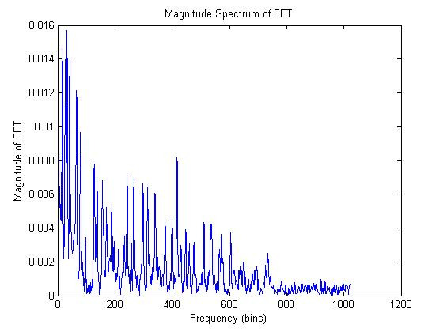
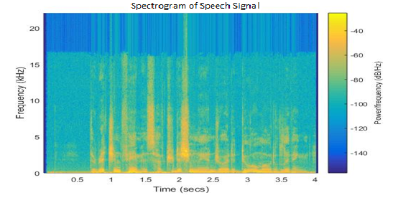
Introduction
Magnitude spectra are widely used to represent, visualize, and perform operations on signals in the frequency domain.
The spectrogram is a series of Short-Time Fourier Transform magnitudes.
STFT Magnitude Equation:
Notes:
In the left: y axis is magnitude of FFT
A spectrogram : y axis : we’re looking at the power spectrum as it changes over time
color represents magnitude of the spectrum, we can see how it changes over time. X axis is time
Both of these representations exclude phase.

Slide 4
Problem Formulation
In many applications, the analysis and modification of the STFT and STFTM of speech and audio signals are necessary.
Phases could be lost or become meaningless as the spectral representations are manipulated or they might even not exist for artificially constructed spectrograms.
Griffin and Lim in 1984 developed an iterative algorithm to estimate a signal based on its STFTM. A drawback of this algorithm is that the phase estimate for a given frame is dependent on all future and all past frames in the original signal.
Notes:
. These applications include, but are not limited to audio enhancement, reverberation analysis, time and pitch modification, and noise cancellation.
G&L:
Add the fact that: G&L is proven to converge to a stable solution. Add a drawback: it is slow to compute because of the number of iterations.
In the G&L algorithm, the main problem is each transform iteration is concurrently applied to all frames, making it non-real time.
Whole signal must be processed for each iteration.
It is also dependent on the initial estimates.

Slide 5
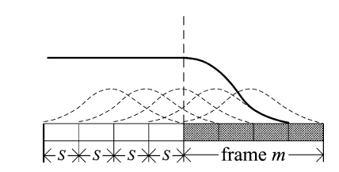
Real Time Interactive Spectrogram Inversion
RTISI: Real Time Iterative Spectrogram Inversion
This method was a variant of the Griffin and Lim Algorithm but was modified to estimate audio frames in sequence rather than in parallel.
Orchestral Music
Orchestral Music with zero Phase
Orchestral Music with random Phase
Partially reconstructed frames in RTISI
Reconstruction with 50
Iterations of G&L
Zhu, X., Beauregard, G. T., & Wyse, L. L. (2007). Real-time signal estimation from modified short-time Fourier transform magnitude spectra. Audio, Speech, and Language Processing, IEEE Transactions on, 15(5)
Reconstruction with 5
Iterations of RTISI
Notes:
G&L does forward and reverse passes. This uses the signal up till the frame which is processed.
Rtisi however offers results which are lower than g&l due to lack lack of look-ahead and optimization toward the future of the signal.
Rtisi-la was then developed which performed phase estimation of RTISI on k frames after the current one, ensuring that the estimated phase for the frame
soon to be committed in the resulting signal was in agreement with the past and future evolutions of the signal. However they don’t show high accuracy.
overall reconstruction quality has not significantly improved

Slide 6
Objective
The objective is to use these spectral representations to generate a real-valued signal that corresponds as closely as possible to the original spectrograms – without iteration.

Slide 7
Steps
The SPSI method begins with a series of magnitude spectra assumed to represent overlapping windowed frames of an actual or hypothetical time-domain signal.
The frames are assumed to be windowed using a Hanning window, with an analysis step size $S$which is one quarter the frame length $L$.

Slide 8
Peak Identification using Quadratic Interpolation
The Quadratic Interpolation technique used follows the algorithm
proposed by Julius O.Smith lll in ‘Spectral Signal Processing’
Notes:
From the magnitude spectrum, we identify the bins that represent peaks in the spectrum by comparing the magnitude of each bin j with that of its neighbors, 𝑗+1 and 𝑗−1.
Quadratic interpolation is then used to identify the true peak position based on the magnitude of the peak bin and its neighbors.
Alpha= magnitude at bin j-1
Beta= magnitude at bin j
Gamma= magnitude at bin j+1
That frequency tells what the phase is- and how fast to rotate the phase to the current frame.
Adjusted phase rate=2pi(j+p)/L
Peakphase+=S*adjusted phase rate

Slide 9
Phase Locking of Bins
Single frequency bin
Peak, p>cf
cf
p
Peak, p<cf
Pi shift
Peak phase
Pi shift
Peak phase
trough
trough
Notes:
Depending on the value of $p$ we have two cases:
If $p<0$, all the bins to the right of the peak bin will have the phase of the peak bin with a shift of pi until the next 'trough' or 'valley‘, as well as bin j—1. Beyond the trough, the bins are locked to the next peak. The bins to the left of the peak bin will have the same phase as that of the peak bin.
If $p$ $≥0$, the same procedure is followed as above, but in reverse.
In both cases, as before, this is carried out only as far as the next trough.

Slide 10
Final Step
The final step is to compute an Inverse Fast Fourier Transform which is Hanning windowed to yield the output frames which are then overlap-added to create a real valued audio signal.

Slide 11
Flowchart of SPSI

Slide 12
Evaluation
Two speech signals and two musical signals. The speech signals consist of one male and one female recording and the musical signals consist of samples of two songs with percussion.
Initial phases are assumed to be zero.
We compare the performance of SPSI with that of Griffin and Lim Algorithm (G&L).
Notes:
Each signal has a duration of 4 seconds and is sampled at a sampling rate of 44100 Hz. We use a window length of 2048 and 75% frame overlap for all the signals.

Slide 13
Results
SAMPLE | SER after 1 ITERATION of G&L | SER after 10 ITERATIONS of G&L | SPSI SER
Male Speaker | 14.40 | 23.50 | 20.82
Female Speaker | 17.04 | 30.02 | 24.25
Music #1 | 15.16 | 30.35 | 26.67
Music #2 | 15.60 | 27.54 | 23.89
Notes:
Compare to the original using a measure knows as the Signal-to-Error Ratio (SER).
The SPSI algorithm yields an SER significantly greater than single-pass G&L algorithm and is lower, though quite close to the SER measured for the G&L algorithm after 10 iterations for each of the four audio signals.

Slide 14
SPSI as initial condition for G&L
SAMPLE | 1 ITERATION | 10 ITERATIONS
Male Speaker | 24.38 | 25.89
Female Speaker | 29.77 | 40.64
Music #1 | 35.05 | 46.17
Music #2 | 30.93 | 42.52

Slide 15
Analysis Summary
After only 1 G&L iteration starting from the SPSI-derived initial condition, the SER is comparable to the 10-iteration zero-phase G&L condition.
After 10 iterations, the G&L algorithm with SPSI derived initial phases produces SER measures that are significantly better than 10-iteration G&L algorithm run starting from zero phase.

Slide 16
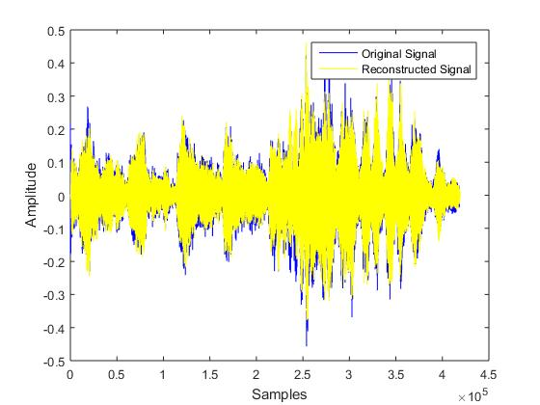
Plots of a Musical Signal and its Reconstructed Version
The SPSI reconstruction is close to the original signal in the time domain as is qualitatively shown in the Figure.
Orchestral Music
Reconstruction of Orchestral
Music with SPSI
Reconstruction of Orchestral
Music with SPSI derived
Phases as Initial Condition
with 10 iterations of G&L

Slide 17
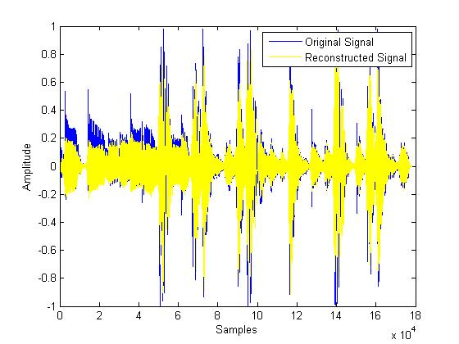
Plots of a Musical Signal and its Reconstructed Version
The SPSI reconstruction is close to the original signal in the time domain as is qualitatively shown in the Figure.
Audio with Percussion
Reconstruction with SPSI
Reconstruction with SPSI derived
Phases as Initial Condition
with 10 iterations of G&L

Slide 18
Other Applications
Using phase prediction / extrapolation
Audio compression
For codecs with polar representation (e.g. MCLT-based)
better than naïve prediction of rotating each bin a nominal bin frequency
Audio restoration
Fix corruption in music files (clicks, dropouts)
Use magnitude spectrum from just before (or after) corruption
Notes:
We also expect that additional improvement in quality could come from allowing non-peak frequency bins to be influenced by more than one neighboring peak.

Slide 19
Future Work
Detailed quality analysis that could use both quantitative and subjective methods.
Further analysis on its use as an initial estimate for the Griffin and Lim Algorithm and its variants could be explored in more detail.
More nuanced phase estimates for bins between peaks
Notes:
We also expect that additional improvement in quality could come from allowing non-peak frequency bins to be influenced by more than one neighboring peak.

Slide 20
Conclusion
The Single Pass Spectrogram Inversion (SPSI) algorithm was developed which estimates phases for spectrogram reconstruction in a single pass.
The advantage of this method over other phase reconstruction methods is the computational simplicity and increased efficiency.
All audio samples and code - from SPSI and RTISI- are available at: http://anclab.org/software/phaserecon/
Notes:
The phase reconstruction performed by this algorithm involves the calculation of peaks in the magnitude spectra of the signal, and the subsequent phase increment at the peaks by pi shifts.
Looking at this from the phase vocoder perspective, it possesses distinct advantages over other methods since no phase unwrapping and arctan calculations are necessary
SPSI also compares favorably with spectrogram inversion algorithms that necessitate many frequency transform iterations.

Slide 21
THANK YOU

